Slide 1

Instructions :
Get out a pen and paper – ruling a margin down the side of your page
Title your page – Human Wellbeing
If you see this symbol it means there is something on the slide which is noteworthy
So write it down

Slide 2

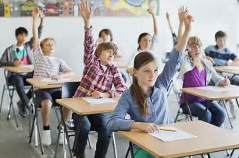
After today you will know…
How to define wellbeing in regards to geography
What wellbeing indicators are/how they are used
How wellbeing is measured
How wealth effects wellbeing

Slide 3
Introducing: the Geography of Wellbeing
What does wellbeing mean to you??

Slide 4


What is Wellbeing??
Wellbeing is defined as:
“The ability of human beings to access the things they
need in order to live happy and healthy lives.”
What do you think is needed to live a happy and healthy life??
What kind of things can impact on your ability to live a happy and healthy life??

Slide 5

Wellbeing indicators are…
Broken into quantitative and qualitative indicators.
Indicators of wellbeing can be classified into a broad range of categories.
These categories are:
Social
Political
Economic
Environmental
Technological
Do you think the indicators within these categories would be the same in every country?

Slide 6
the categories…
Social – Measures the demographic, social and health indicators, such as; population growth, literacy and life expectancy.
Political – Measures the effective governance and the opportunity to live and work in safety, such as; defence expenditure and female parliamentarians.
Economical – Measures income and employment to help quantify living standards, such as; Gross National Income.
Environmental – Assesses natural and man-made environmental resources such as; access to fresh water and CO2 emissions.
Technological – Technologies impact on living standards, such as; access to electricity and the internet.

Slide 7

Why Use indicators?
Helps geographers to identify patterns and attempt to explain why these patterns exist.
Also helps to explain why the world is so unequal.
What factors can influence equality among countries??
Availability of natural resources
Educated work force
Climate conditions
Natural disasters
Government styles

Slide 8
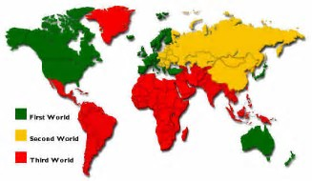

Describing development…
The old system to categories the development of countries was developed during the Cold War.
The categories were: - First, Second and Third World countries
The new system has countries are divided by wealth into one of two categories: More Economically Developed (MEDC) or Less Economically Developed (LEDC).

Slide 9
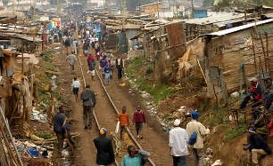
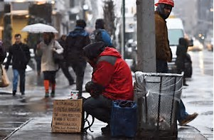
Describing poverty…
There is a strong correlation between development and poverty.
Poverty is defined as:
“A denial of choices and opportunities, a violation of
human dignity.’
In simple terms it means not having; enough to feed/clothe a family, a school/clinic to go to, land or a job to earn a living.
More than 1 billion people live in poverty.

Slide 10

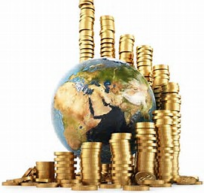
Wealth’s impact on wellbeing
Access to the basic necessities of life are determined largely by the degree of wealth a person possesses.
Wealth is generated by; producing/selling things, earning wages from work, making investments or owning assets.
If you lack access to wealth it’s difficult to buy things such as; food, medicine and life necessities.
There are huge variations in wealth across the globe.

Slide 11

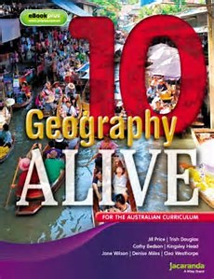
Geography Alive question to do…
Pg. 113
All ‘Explain’ Questions
Think – Q.6, Q.7
Pg. 115
Think – Q.4

